Slide 1
Software architecture and design

Slide 2
Software Design
Architectural Design – Highest level of Abstract of the system, may just get the solution domain
High-level Design – System to Subsystems, Functions of each subsystem, interaction with each other
Detailed Design – Implementation details of each subsystem, interfaces like function names, inputs and outputs of each function, data structure for each variable i.e. defines logical structure of each module, each interface
Notes:
• Architectural Design - The architectural design is the highest abstract version of the system. It identifies the software as a system with many components interacting with each other. At this level, the designers get the idea of proposed solution domain.
• High-level Design- The high-level design breaks the ‘single entity-multiple component’ concept of architectural design into less-abstracted view of sub-systems and modules and depicts their interaction with each other. High-level design focuses on how the system along with all of its components can be implemented in forms of modules. It recognizes modular structure of each sub-system and their relation and interaction among each other.
• Detailed Design- Detailed design deals with the implementation part of what is seen as a system and its sub-systems in the previous two designs. It is more detailed towards modules and their implementations. It defines logical structure of each module and their interfaces to communicate with other modules.

Slide 3
Design phases
Architectural design: Identify sub-systems
Abstract specification: Specify sub-systems
Interface design: Describe sub-system interfaces
Component design: Decompose sub-systems
into components
Data structure design: Design data structures to hold problem data
Algorithm design: Design algorithms for problem functions

Slide 4
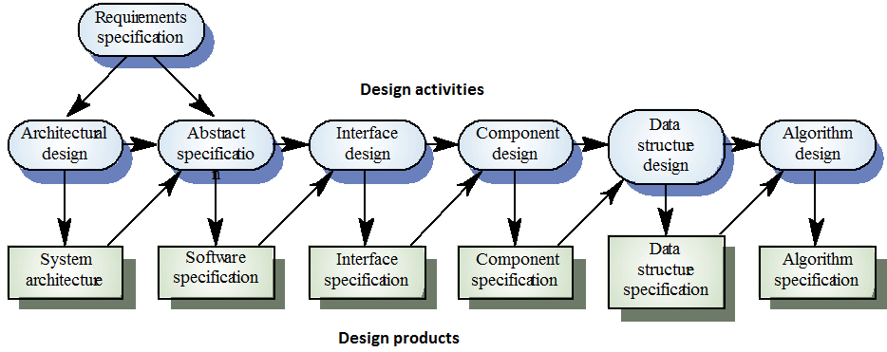
Phases in the design process

Slide 5
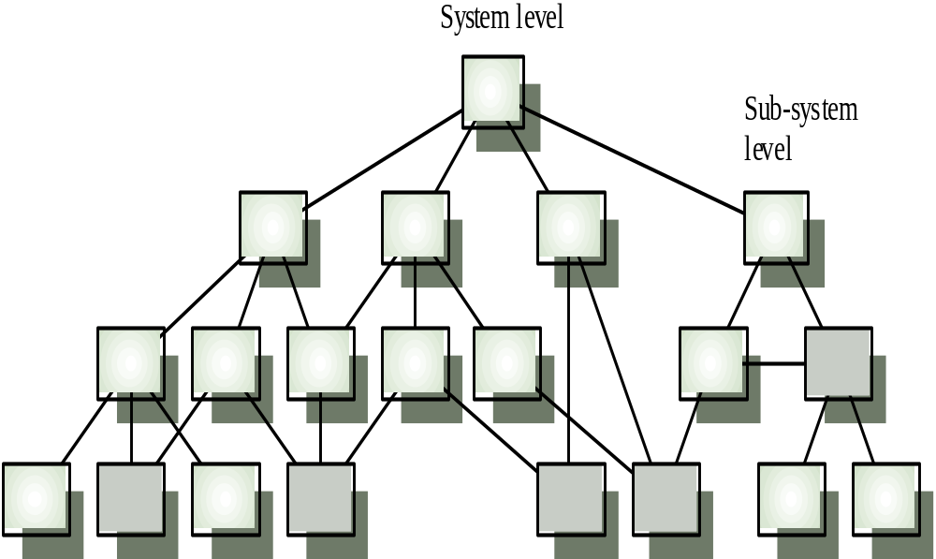
Hierarchical design structure

Slide 6
Principles - PHAME
Hierarchy – Refers to the organization of a program component
Abstraction – Removal of unnecessary details
Modularity - well defined, independent components – maintainability, tested in isolation, supports team work, reusability
Encapsulation – Minimizes interdependencies among modules
Notes:
PHAME- Principles of Hierarchy, Abstraction, Modularity, Encapsulation

Slide 7
Analysis Vs Design
ANALYSIS | DESIGN
Focus - WHAT | Focus - HOW
At Concept level | Towards Realization
Understanding the problem | Understanding the solution
Idealized design | Operations and Attributes
(Generalized) Behavior | Performance, Efficiency…
Separation of Concerns
System structure | Close to real code
Functional requirements | FRs in detail
Some recognition for NFR | NFRs in detail
A small model | A large model

Slide 8
Why do we need models?
To create a simplified representation of a real software system

Slide 9
Modeling
Modeling is a way of thinking about the problems and it organizes the real world ideas.
A modeling method comprises a language and also a procedure for using the language to construct models.
Modeling is the only way to visualize your design and check it against requirements before your crew starts to code.

Slide 10
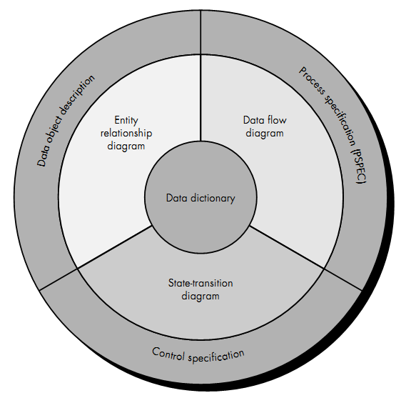
The structure of the analysis model

Slide 11
What is UML?
A popular, standardized modeling language for object-oriented software.
The Object Management Group (OMG) is the group that dictates the UML standard.
Created by Grady Booch, James Rumbaugh, and Ivar Jacobson.
It is used for both database and software modeling.

Slide 12
The Unified Modeling Language
Process
Specify
Construct
The UML Goal
Visualize
Document

Slide 13
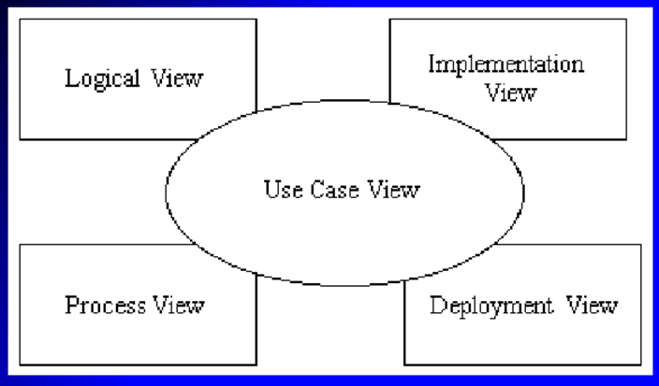
UML Concepts-The 4+1 view
Use Case view
    Understandability
Logical View
    Functionality
Process View
    Performance
    Scalable
    Throughput
Implementation View
    Software management
Deployment View
    System topology
    Delivery
    Installation

Slide 14
UML Models
Functional Models
  Use case diagrams
Structural Models
  Class diagrams
Dynamic/Behavioral Models
  Statechart diagrams
  Sequence diagrams
  Activity diagrams

Slide 15
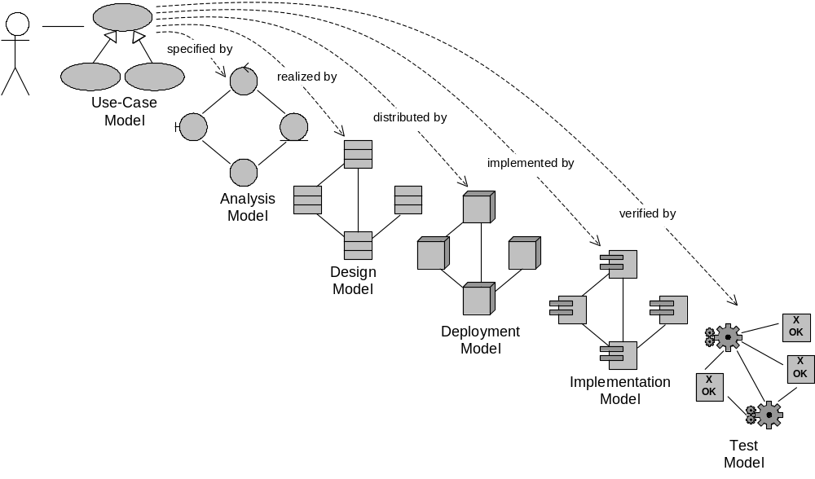
Unified Process
The use case model is supposed to define the requirements posed on the system and is intended to drive the whole development process.

Slide 16
Diagrams in UML
A Diagram is the graphical presentation of a set of elements, most often rendered as a connected graph of things and relationships. UML includes 9 such diagrams.
1. Class Diagram.
2. Object Diagram.
3. Use Case Diagram.
4. Sequence Diagram.
5. Collaboration Diagram.
6. State Chart Diagram.
7. Activity Diagram.
9. Deployment Diagram.

Slide 17
There are 9 types of diagrams in UML
Dynamic views
Static views
Use Case
Diagrams
Sequence
Diagrams
Some part of
the model might
not be visible on
any diagram
Class
Diagrams
Collaboration
Diagrams
Object
Diagrams
Activity
Diagrams
Model
Component
Diagrams
Statechart
Diagrams
Deployment
Diagrams

Slide 18
USE CASE DIAGRAMS

Slide 19
Use case diagrams
Use Case Diagrams describe the functionality of a system and users of the system. These diagrams contain the following elements:
Actors, which represent users of a system, including human users and other systems.
Use Cases, which represent functionality or services provided by a system to users.

Slide 20
Use case diagram symbols
Actor
Relationships
Use case
System

Slide 21
Use case example
Actors don’t have to be people
Shows how actors interact with the system
Report location
Find arrival times
Passenger
GPS System
Report error

Slide 22
High Level Use Case Diagram
Manage Resources
Resource Manager
Manage Projects
Project Manager
System Admin
System Administrator

Slide 23
Managing Resources Use Case Diagram
Add Skill
Remove Skill
Find Skill
Update Skill
Resource Manager
Add Resource
Find Resource
Remove Resource
Update Resource
Assign Skill from Resource
Unassign Skill from Resource

Slide 24
CLASS DIAGRAMS

Slide 25
Class Diagrams
Class Diagrams describe the static structure of a system, or how it is structured rather than how it behaves. These diagrams contain the following elements.
Classes, which represent entities with common characteristics or features. These features include attributes, operations and associations.
Associations, which represent relationships that relate two or more other classes where the relationships have common characteristics or features.

Slide 26
UML Class Diagram Symbols
CLASS
Class Name
Class 1
Inheritance relationship
Class 2 and Class 3 derive from Class 1
Class 2
Class 3
Notes:
Composition: Class 1 has Class 2 but Class 2 does not have Class 1

Slide 27
UML Class Diagram Example
SimpleWatch
1
1
1
1
2
1
2
1
PushButton
Display
Battery
Time
SimpleWatch class contains
2 PushButtons
1 Display
2 Batteries
1 Time

Slide 28
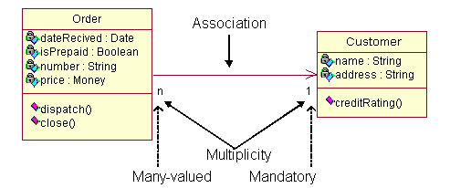
UML Class Diagram Example
  The class Order is associated with the class Customer
  The multiplicity denotes the number of objects
  For example, Order object can be associated only one customer but a customer can be associated to many orders

Slide 29
High-Level Resource Class Diagram
Skill
Resource-Skill
Resources
Salaried
Hourly

Slide 30
Detailed Resource Class Diagram
Skill
Name: String
Desc: String
Create(): Skill
setName(): (Name:String)
getName(): String
setDesc(): (Desc:String)
getDesc(): String
destroy()
Resource Skill
Resource
Salaried
Hourly

Slide 31
Relationships
In UML, object interconnections (logical or physical), are
modeled as relationships.
There are three kinds of relationships in UML:
  dependencies
  generalizations
  associations

Slide 32
Dependency Relationships
A dependency indicates a semantic relationship between two or more elements. The dependency from CourseSchedule to Course exists because Course is used in both the add and remove operations of CourseSchedule.
CourseSchedule
Course
add(c : Course)
remove(c : Course)

Slide 33
Generalization Relationships
Person
A generalization connects a subclass to its superclass. It denotes an inheritance of attributes and behavior from the superclass to the subclass and
indicates a specialization in the subclass of the more general superclass.
Student

Slide 34
Association Relationships
If two classes in a model need to communicate with each other, there must be link between them.
An association denotes that link.
Student
Instructor

Slide 35
Object Diagrams
.
Object Diagrams describe the static structure of a system at a particular time. Whereas a class model describes all possible situations, an object model describes a particular situation. Object diagrams contain the following elements:
Objects, which represent particular entities. These are instances of classes.
Links, which represent particular relationships between objects. These are instances of associations.

Slide 36
SEQUENCE DIAGRAMS

Slide 37
Sequence Diagrams
Describe the dynamic behavior between actors and the system and between objects of the system
Used during requirements analysis
  To refine use case descriptions
  To find additional objects
Used during system design
  To refine subsystem interfaces

Slide 38
Sequence diagram notation
Classes are represented by columns
Messages are represented by arrows
Activations represented by narrow rectangles
Lifelines are represented by dashed lines

Slide 39
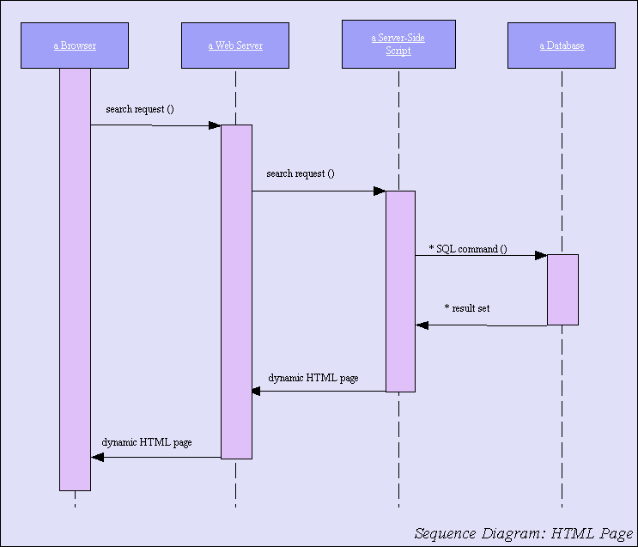
Sequence Diagram

Slide 40
Collaboration Diagrams
Collaboration Diagrams describe interactions among classes and associations. These interactions are modeled as exchanges of messages between classes through their associations. Collaboration diagrams are a type of interaction diagram. Collaboration diagrams contain the following elements.
Class roles, which represent roles that objects may play within the interaction.
Association roles, which represent roles that links may play within the interaction.
Message flows, which represent messages sent between objects via links. Links transport or implement the delivery of the message.

Slide 41
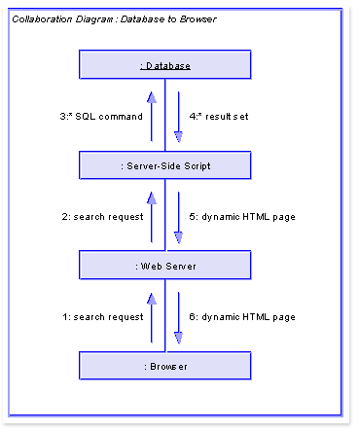

Slide 42
ACTIVITY DIAGRAMS

Slide 43
Activity Diagrams
Used to represent the behavior of a system in terms of activities and their precedence constraints
Compared to flowchart diagrams because …
  They can be used to represent control flow (order in which operations occur)
  They can be used to represent data flow (objects exchanged among operations)
The completion of an activity triggers an outgoing transition which may initiate another activity

Slide 44
Symbols
- Synchronization of the control flow
- Activities in the system
- Transitions between activities

Slide 45
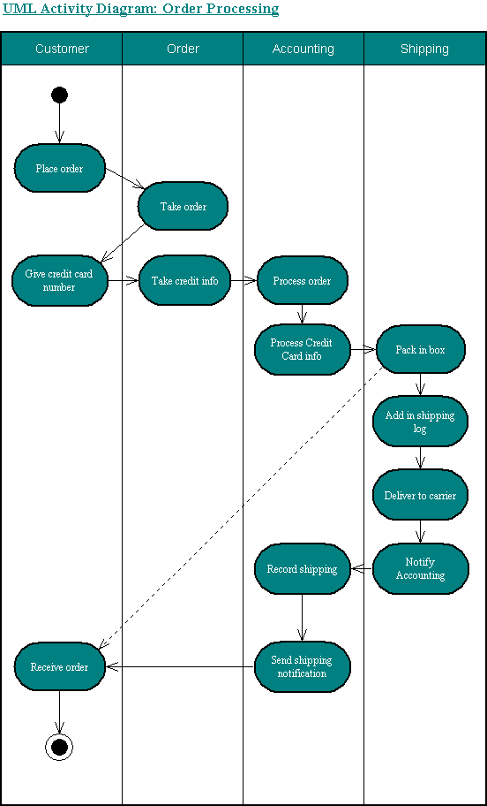
Activity Diagram

Slide 46
Component Diagrams
Component diagrams describe the organization of and dependencies among software implementation components.
These diagrams contain components, which represent distributable physical units, including source code, object code, and executable code.

Slide 47
Component diagram -
Captures the Physical Structure of the Implementation
applet1.class
applet1.java
Demo.html
applet2.class
applet2.java
logo.gif

Slide 48
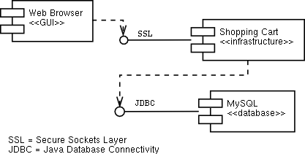
Component Diagram Example

Slide 49
Deployment Diagrams
Deployment diagrams describe the configuration of processing resource elements and the mapping of software implementation components onto them. These diagrams contain components and nodes, which represent processing or computational resources, including computers, printers, etc.

Slide 50
Deployment diagram
Extended
VLAN
”Server”
”network” LAN
”PC”
”PC”

Slide 51
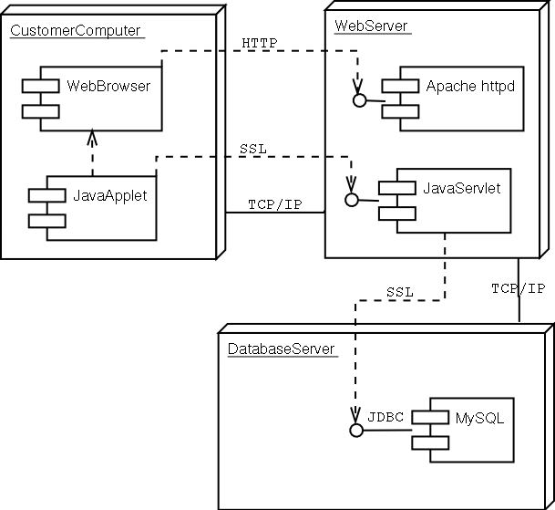
Example

Slide 52
STATECHART DIAGRAMS

Slide 53
UML Statechart Diagram
A statechart diagram shows the behavior of classes in response to external stimuli
This diagram models the dynamic flow of control from state to state within a system.

Slide 54
State chart Diagrams
State Chart (or state) diagrams describe the states and responses of a class. State Chart diagrams describe the behavior of a class in response to external stimuli. These diagrams contain the following elements:
States, which represent the situations during the life of an object in which it satisfies some condition, performs some activity, or waits for some occurrence.
Transitions, which represent relationships between the different states of an object.

Slide 55
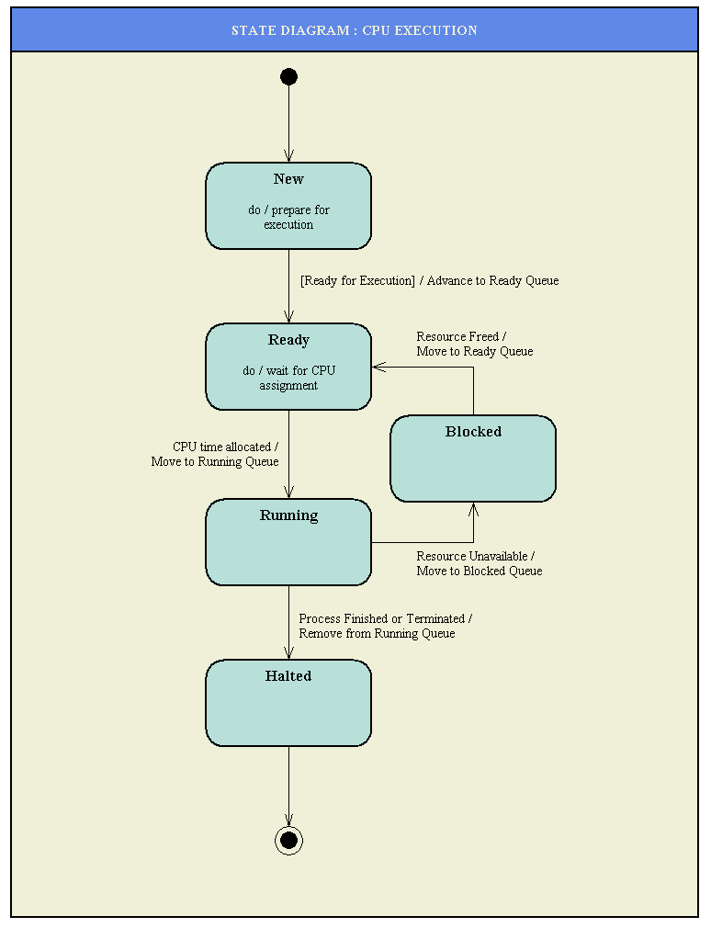
State Chart Diagram

Slide 56

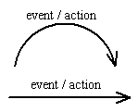


Basic Statechart Diagram Symbols and Notations
States represent situations during the life of an object
A solid arrow represents the path between different states of an object
A filled circle followed by an arrow represents the object's initial state.
An arrow pointing to a filled circle nested inside another circle represents the object's final state.

Slide 57
States, Transitions, Events
A state is a mode or condition of being.
A transition is a change from
one state to another.
An event is a noteworthy
occurrence at a particular time.

Slide 58
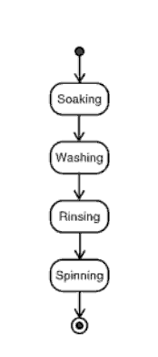
States of an object

Slide 59
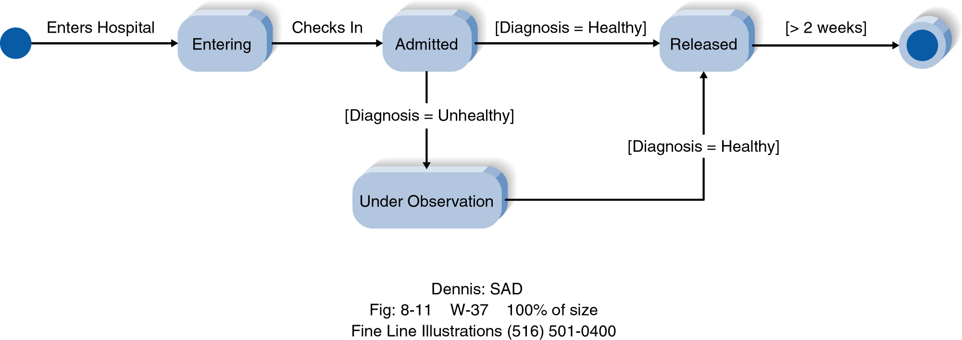
Example State Diagram

Slide 60
State Diagram Syntax
A STATE
AN INITIAL STATE
A FINAL STATE
AN EVENT
A TRANSITION
aState
anEvent

Slide 61
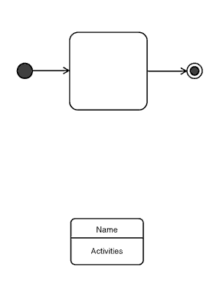
State Diagram Syntax

Slide 62
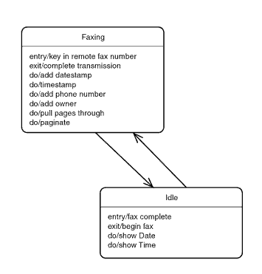
State Diagram Syntax

Slide 63
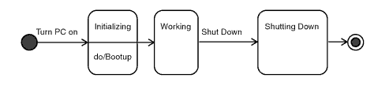
Example State Diagram

Slide 64
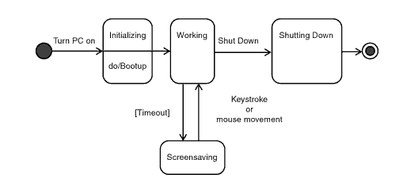
Example State Diagram

Slide 65
Worked example
Customer creates order on the Web
Customer submits order once finished
Credit authorisation needs approval before order is accepted
If denied, order is returned to customer for changes or deletion
If accepted, order is placed
Order is shipped to customer
Customer receives order
Order is closed

Slide 66
Nested State Diagrams
State diagrams for an object may be nested, allowing the control mechanism to be viewed at different levels of abstraction.
A nested state diagram is a form of generalisation on states.

Slide 67
Another Example - Digital Watch
A simple digital watch has a display and two buttons to set it, the A button and the B button. The watch has two modes of operation, display time and set time.
In the display time mode, hours and minutes are displayed.
The set time mode has two sub modes: set hours and set minutes.
The A button is used to select modes. Each time it is pressed, it advances through the modes: display, set hours, set minutes, display...etc. Within the sub modes, pressing B will advance the hours or minutes each time it is pressed. Buttons must be released before they generate another event.

Slide 68
States, Transitions, Events
A state is a mode or condition of being.
A transition is a change from
one state to another.
An event is a noteworthy
occurrence at a particular time.

Slide 69
UML State Diagrams
Represent states by rounded rectangles containing the state name
Represent transitions by solid arrows labeled with one or more transition strings
Transition strings
  Describe triggering circumstances
  Actions that result
Initial pseudo-state designates the initial state
Optional final state represents halting

Slide 70
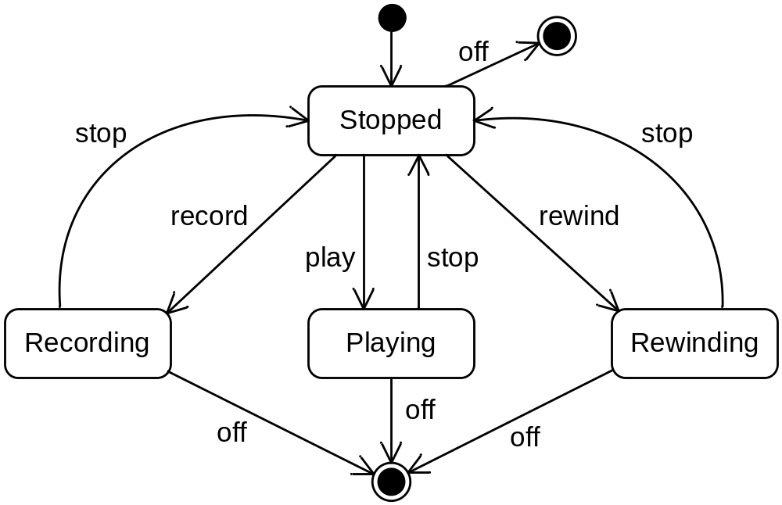
State Diagram Example

Slide 71
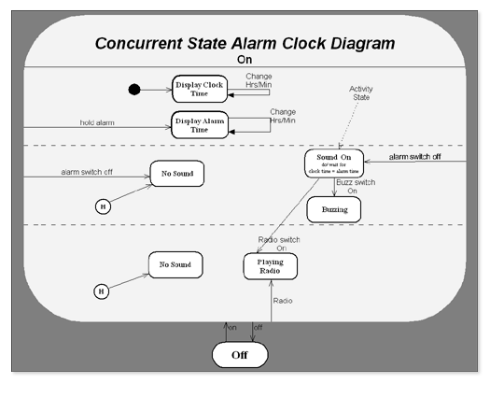

Slide 72
Description of state chart diagram
State:
  Display alarm time
  Display clock time
  No sound
  Sound on
  Buzzing
  Playing radio
Transition:
  On
  Off
  Hold alarm
  Alarm switch off
  Change Hrs/Min
  Radio
Activity:
  Do/wait for clock time to alarm time

Slide 73
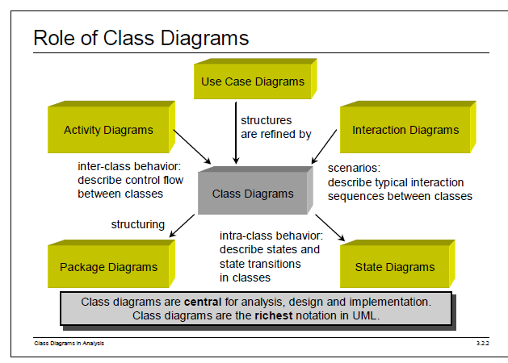


Slide 74
Case Study on Online Shopping Portal
In this case, we will be designing a simple online shopping portal .The site will provide a soothing shopping experience for customers. The system will allow more than one categories and different brands under the segment. The case will trace the following sequence.

Slide 75
Scenario
A customer visits the online shopping portal. A customer may buy item or just visit the page and logout. The customer can select a segment, then a category, and brand to get the different products in the desired brand. The customer can select the product for purchasing. The process can be repeated for more items. Once the customer finishes selecting the product/s the cart can be viewed, If the customer wants to edit the final cart it can be done here. For final payment the customer has to login the portal, if the customer is visiting for the 1st time he must register with the site, else the customer must use the login page to proceed. Final cart is submitted for payment and card details and address (where shipment has to be made) are be confirmed by the customer .Customer is confirmed with a shipment Id and delivery of goods within 15 days.

Slide 76
Assumptions
The currency followed is Rs as the site provides for only Indian customer base.
There are different segments, categories, brands where a brand can fall under more than one category.
The shipment of the goods is not covered under the scope of the case.
Complains by the customers are not handled by the case study.
Customers have to be validated before the payment can be confirmed.
Draw the Use Case Diagram, Class Diagram, Activity Diagram..
Sequence Diagram for the Following Activities:
1) For Register A New User.
2) For Adding A New Product to System.

Slide 77
Actors
Two actors
Customer
Admin

Slide 78
Use-cases
Select
Add to cart
Submit Cart
  Pay Bill

Slide 79
If the customer is visiting for the 1st time he must register with the site, else the customer must use the login page to proceed.
  Register
  Login

Slide 80
Add Segment
Add Brand
Add Product

Slide 81
The customer can select a segment, then a category, and brand to get the different products in the desired brand.
Select a Segment
Select a Category
Select a Product
Select a Brand

Slide 82
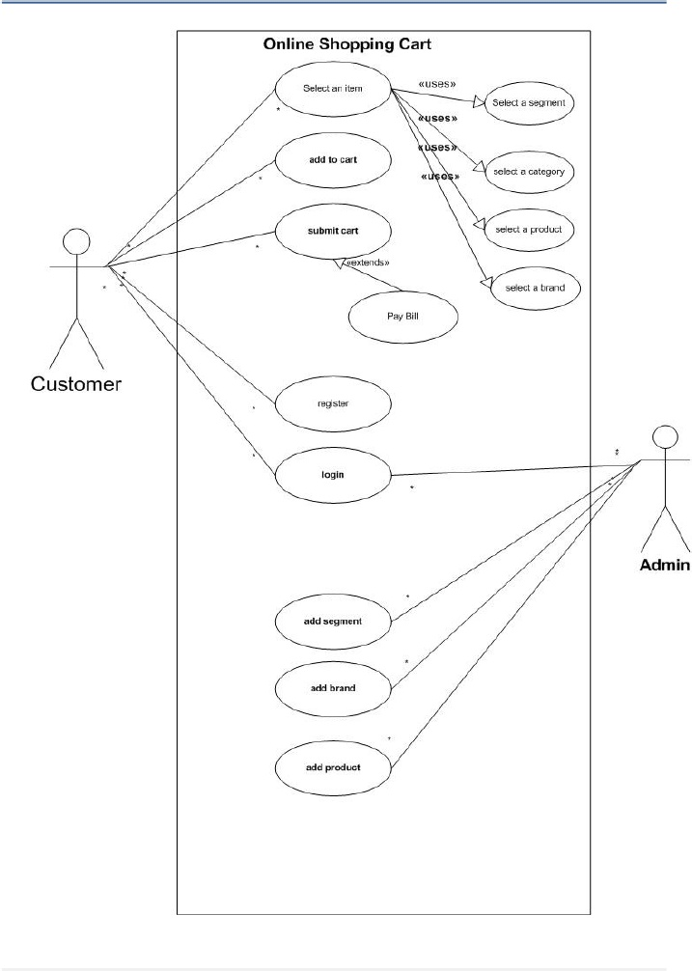

Slide 83
The customer can select a segment, then a category, and brand to get the different products in the desired brand.

Slide 84
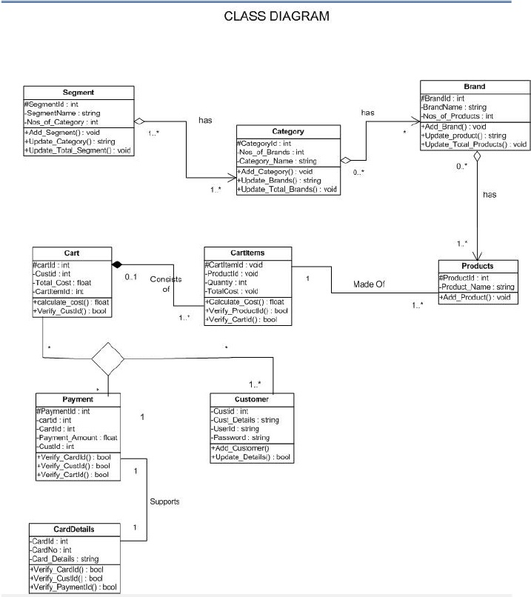

Slide 85
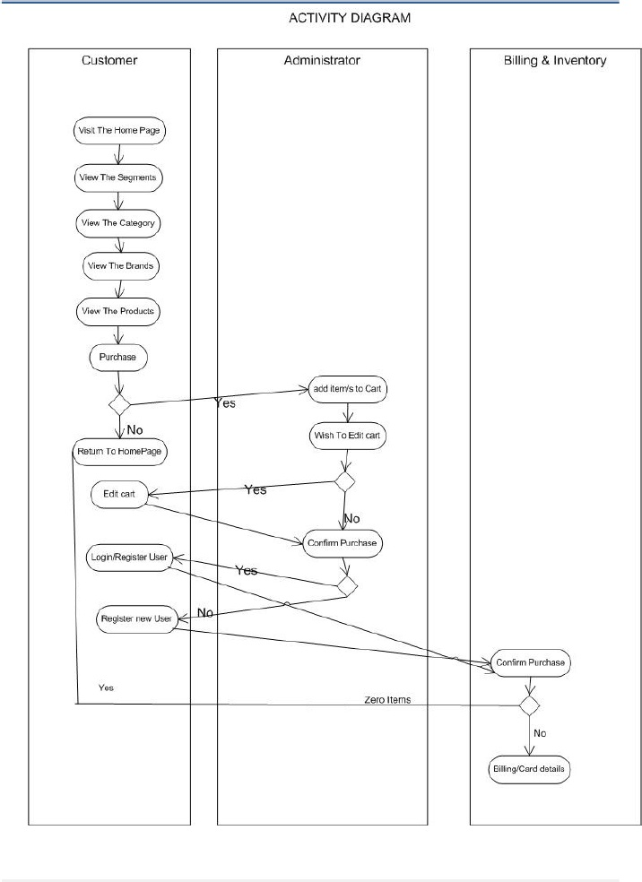

Slide 86
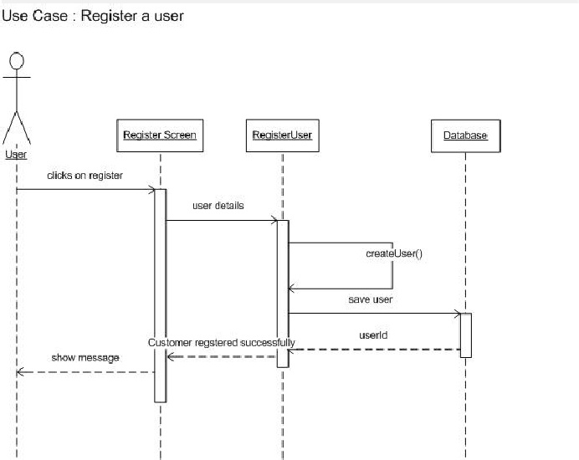

Slide 87
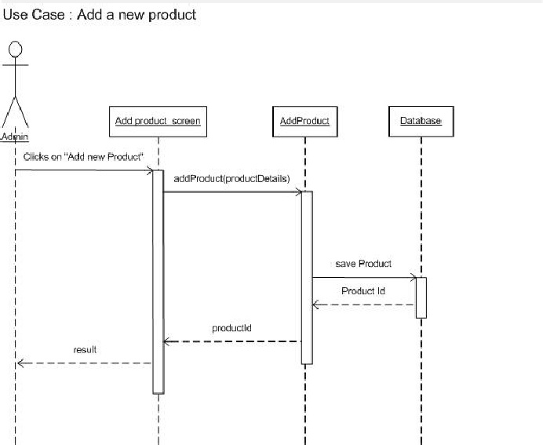

Slide 88
Draw Use Case diagram, Class Diagram and Sequence diagram for Automated Teller Machine (ATM). The ATMs will allow customers to access details of their account, such as the balance enquiry, withdraw cash provided they have sufficient funds remaining, fund transfer etc. Customers will use the ATM by inserting their account card and entering a 4-digit PIN. Customers should be able to change this PIN via the ATM as well.

Slide 89
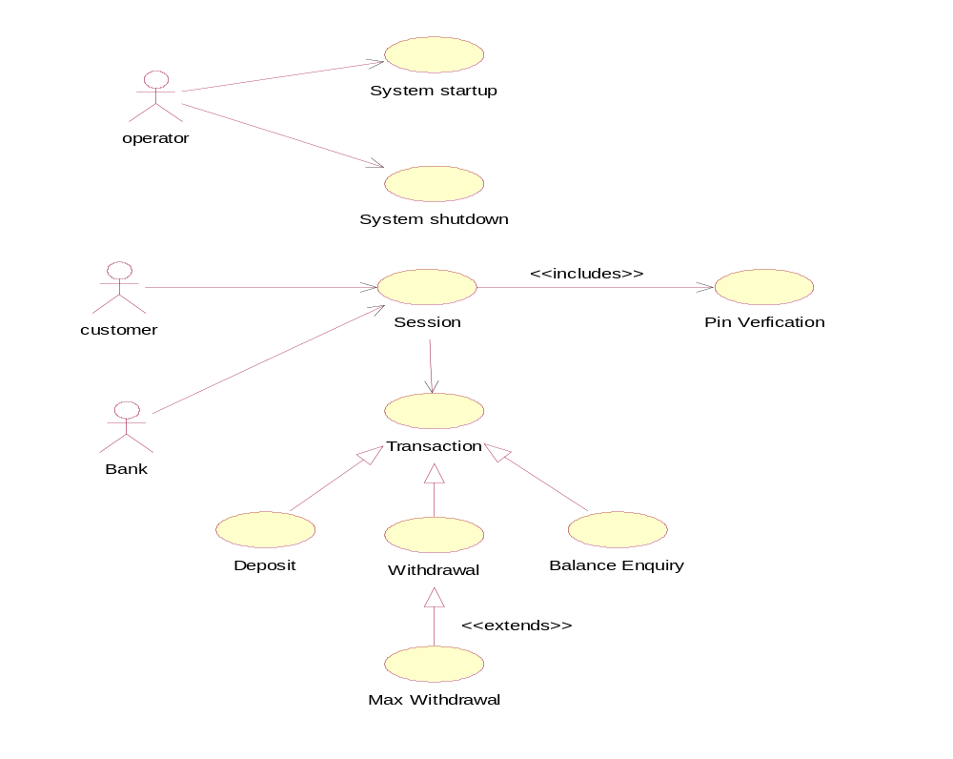

Slide 90
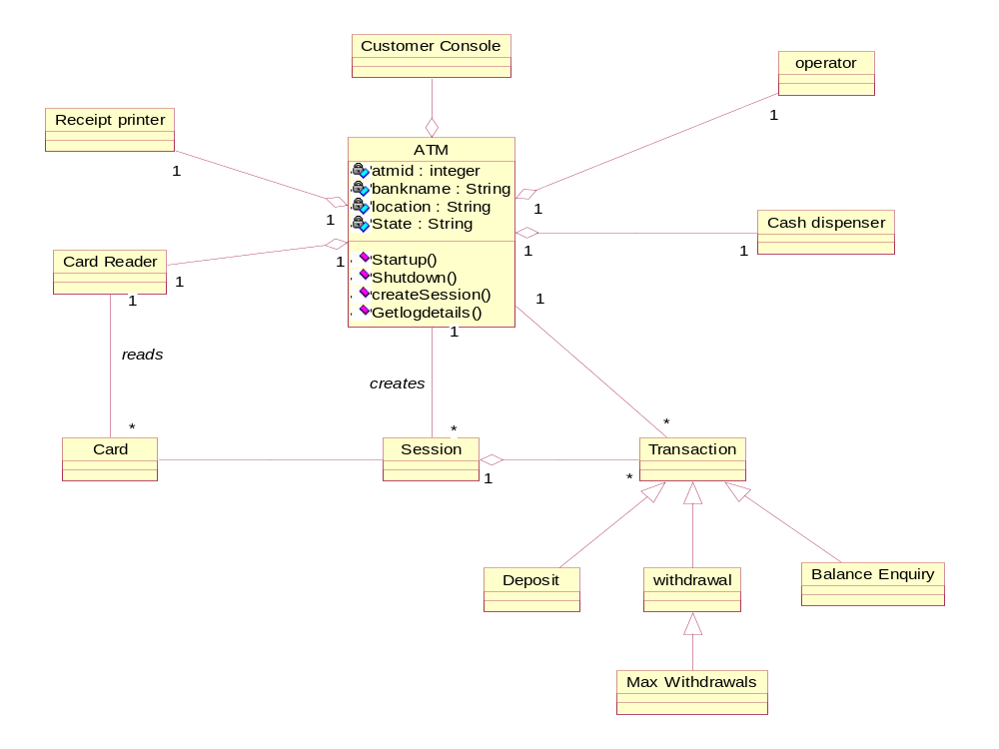

Slide 91
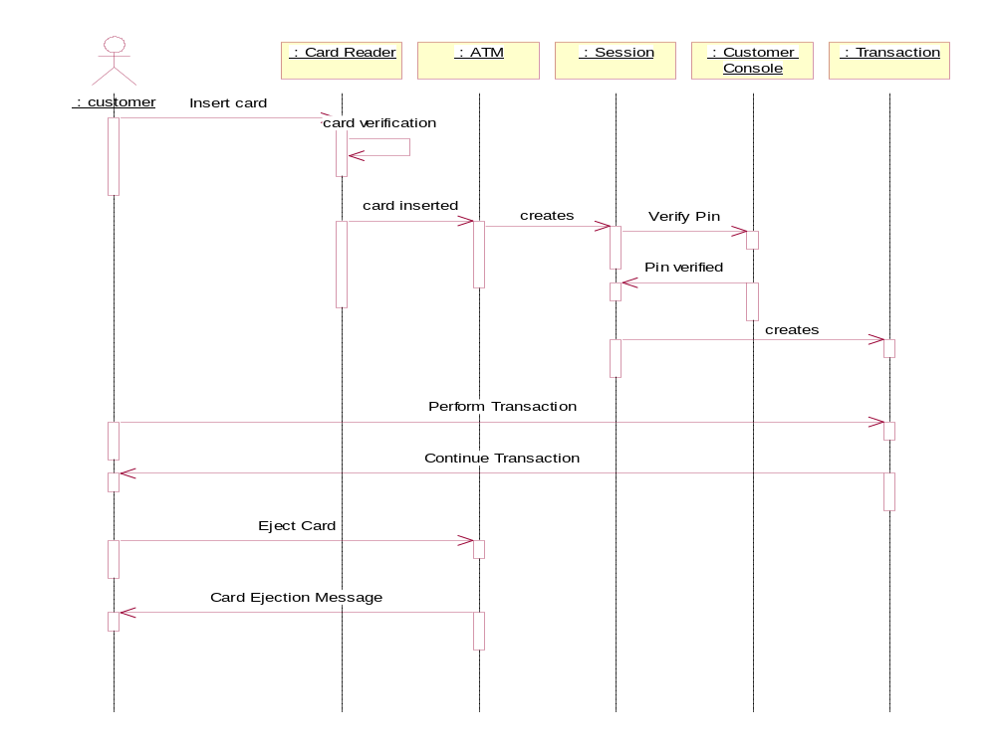

Slide 92
Online Transaction System
Account transaction begins when customer is successfully logged in to the site. Several menus were displayed related to profile of customer and the recent transactions and the current account balance. The main purpose of using online account transactions is to transfer cash from one account to another for this purpose the customer is provided fields to specify the accounts to which he is transferring amount. After every transaction a confirmation is displayed to customer. The customer is also provided the possibility to change the account login password, but not the user id, every transaction is added to the bank database.

Slide 93
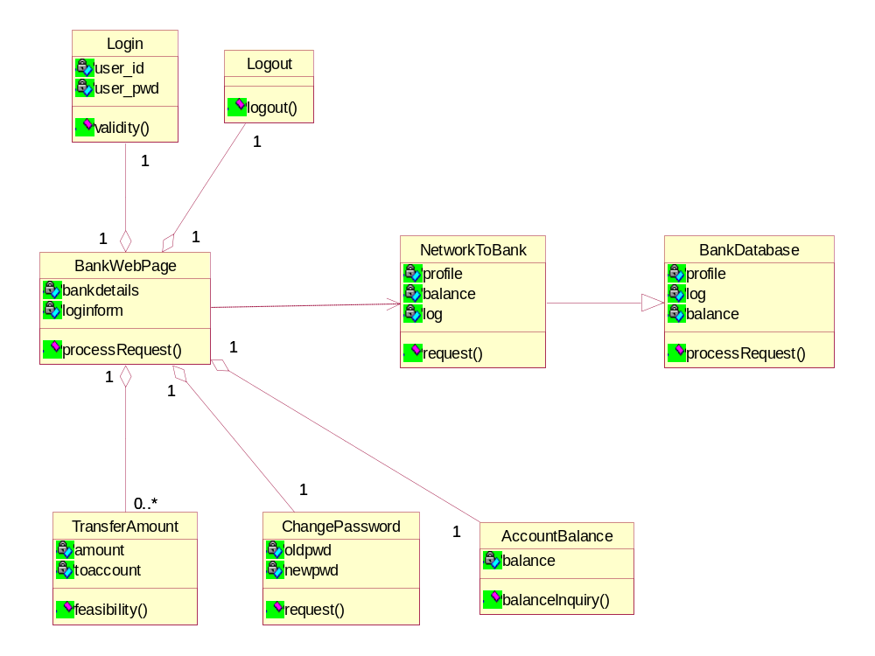

Slide 94
Given the following assertions for a relational database that represents the current term enrollment at a large university, draw an UML diagram for this schema that takes into account all the assertions given. There are 2000 instructors, 4000 courses, and 30,000 students.
Use as many UML constructs as you can to represent the true semantics of the problem.
Assertions:
An instructor may teach none, one, or more courses (average is 2.0 courses)
An instructor must advise the research of at least one student (average = 2.5 students)
A course may have none, one, or two prerequisites (average = 1.5 prerequisites)
A course may exist even if no students are currently enrolled
All courses are taught by only one instructor.
The average enrollment in a course is 30 students.
A student must select at least one course per term (average = 4.0 course selections).

Slide 95
1
*
0 .. 2
Instructor
Course
teacher
prerequisite
advisor
1 .. *
researcher
1 .. *
Student
*
Enrollment
term

Slide 96
Draw UML class diagrams for a car rental agency database (e.g. Hertz), keeping track of current rental location of each car, its current condition and history of repairs, and customer information for a local office, expected return date, return location, car status (ready, being-repaired, currently rented, being-cleaned). Select attributes from your intuition about the situation. Draw one diagram showing the relationships of the classes without the attributes listed. Then show each class individually with the attributes listed.

Slide 97
branch-rented-from
1
Branch-office
1
branch-returned-to
*
1
*
*
Customer
Rental-history
*
1
1
*
Car
Repair-history

Slide 98
Customer
Branch-office
Rental-history
customer-id
last-name
first-name
middle-initial
street-address
city
state
zip
drivers-license
state-of-license
credit-card-type
credit-card-number
branch-id
street-address
city
state
zip
manager-id
manager-last-name
manager-first-name
manager-middle-initial
manager-phone
manager-email
manager-fax
car-id
date-rented
time-rented
date-returned
time-returned
mileage-out
mileage-returned
customer-id
branch-id-rented-from
branch-id-returned-to
date-expected-return
Car
Repair-history
car-id
make
model
year
color
license-plate
license-state
status
car-id
date-to-shop
date-returned
problem-type
shop-employee-id

